Slide 1
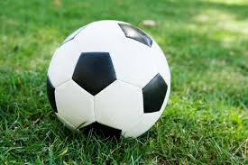
Daily Review
While playing soccer one day, you notice that the players wearing hard shoes can kick the ball further than those wearing soft shoes. This is an example of an observation.
You could try to explain this observation by making an inference. For example: ‘Hard shoes allow a soccer player to kick the ball further.’
You decide to test your inference by doing an experiment. To do this, you need a question to answer, such as ‘Do hard shoes allow a soccer player to kick the ball further?’
The aim of this experiment would be ‘To find out whether hard shoes allow a soccer player to kick the ball further.’
Lastly, the experiment needs a hypothesis: a statement to test. This could be as simple as ‘Hard shoes allow a soccer player to kick the ball further.’
Vocabulary
ob·ser·va·tion (noun) a statement about something you have noticed with your senses in·fer·ence (noun) an explanation of an observation aim (noun) a purpose, intention, or desired outcome hy·po·the·sis (noun) a testable statement

Slide 2
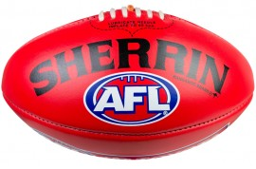
Daily Review
While playing AFL the next day, you notice that the ball is slightly flat. When you kick this ball, it doesn’t go as far as a fully inflated ball would. You’ve made another observation.
On your whiteboard, write an inference for this observation.
You decide to test your inference by doing an experiment. Write the question your experiment is trying to answer.
What is the aim of your experiment? (Hint: start with “To…”)
Write a hypothesis for your experiment.
Hints
Observation: a factual statement about something you have noticed with your senses. What can you see / sense? Inference: a likely explanation of an observation. Why might the thing you observe be happening? Question: the question you are trying to answer by running your experiment. Aim: the goal of your experiment; usually starts with “To…”. Why are you doing this experiment? Hypothesis: a statement which your experiment is testing. What are you trying to prove?

Slide 3
Tables Year 7 Science

Slide 4
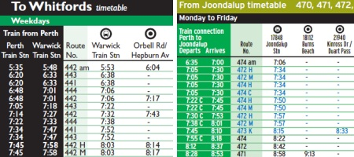
Learning Objectives
CFU 1
What will we be doing with tables today?
We are learning to:
Correctly read and create tables that contain scientific data.
CFU 2
What will these tables contain?
Activate Prior Knowledge
CFU 3
What is data?
A table that you use on a regular basis is your timetable.
What information does your timetable contain?
Think, Pair, Share: why is a timetable more helpful than a list of your classes?
Think, Pair, Share: where else do you use tables?
Vocabulary
da·ta (noun) information that is recorded in an organised way

Slide 5
Concept Development
CFU 1
How many rows does this table contain?
Tables are used by scientists to record and communicate their findings in an organised way.
Tables are made up of the following parts:
CFU 2
How many columns does this table contain?
individual boxes called cells
vertical columns
CFU 3
How many cells does this table contain?
horizontal rows

Slide 6
Concept Development
CFU 1
What are headings for?
Tables are used by scientists to record and communicate their findings in an organised way.
When creating tables, you need to keep the following things in mind:
Your table should always have a title that tells the reader what the table is about.
The first row should contain headings that tell the reader what is in each column (including units).
The first column should be used for your independent variable.
The second column should be used for your dependent variable.
CFU 2
What should your first column be used for?
CFU 3
What goes in your second column?
Hint
Because your units are included with your heading, you don’t need to put them next to your numbers!

Slide 7
Concept Development
Tables are used by scientists to record and communicate their findings in an organised way.
For example, let’s say we were running an experiment with the following aim:
To find out if the temperature of water affects how fast salt dissolves in it.
A table for this experiment’s results might look like this:
Hint
Because your units are included with your heading, you don’t need to put them next to your numbers!
descriptive title
Effect of water temperature on dissolving salt
Temperature of water (°C) | Time to dissolve (s)
10 | 16
30 | 9
50 | 6
Reminders:
All tables need: A title Headings with units in the first row I.V. in the first column, D.V. in the second
independent variable
headings with units
dependent variable

Slide 8
Skill Development / Guided Practice
CFU 1
What are the two variables (things that can change) in Jane’s experiment?
Jane is running an experiment with the following aim:
Aim: to find out how much hot water cools down over time.
Jane creates the following table for her data.
Think, Pair, Share: what has Jane left out?
Hint: the reminders might help you…
CFU 2
Which one of these is the dependent variable (being measured)?
Water temperature over time
Time | Temperature
5 | 43
10 | 37
15 | 35
20 | 24
Time (min) | Temperature (°C)
5 | 43
10 | 37
15 | 35
20 | 24
CFU 3
Which one of these is the independent variable (being changed)?
Reminders:
All tables need: A title Headings with units in the first row I.V. in the first column, D.V. in the second
Notes:
At this point it would be worth asking some CFU questions about reading the table, e.g. “how hot was the water after 10 minutes?” or “how long did it take for the water to reach 35 °C?”

Slide 9
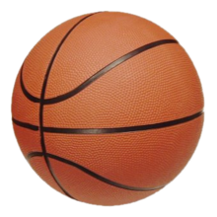
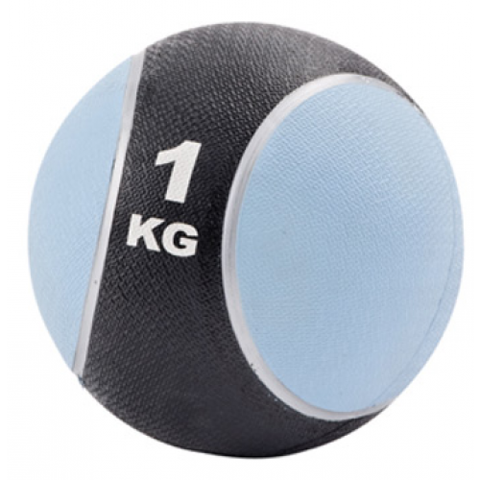
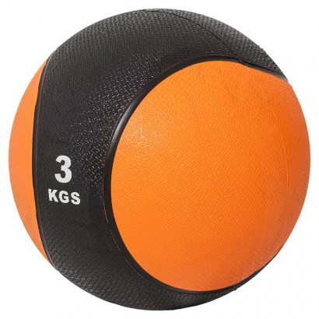
Skill Development / Guided Practice
CFU 1
What are the two variables (things that can change) in Dave’s experiment?
Dave is describing an experiment he did. He says:
“I was trying to measure how the weight of a ball affects how long it takes to hit the ground. I dropped a 500g ball, a 1kg ball, and a 3kg ball. They were all the same size, and I dropped them all from the same height… but they all took 3 seconds to hit the ground!”
On your whiteboard, create a table for Dave’s data.
All of your units need to be the same, so you might need to do a conversion or two.
Don’t forget to check the reminders!
CFU 2
Which one of these is the dependent variable (being measured)?
CFU 3
Which one of these is the independent variable (being changed)?
Reminders:
All tables need: A title Headings with units in the first row I.V. in the first column, D.V. in the second

Slide 10
Relevance
Knowing how to read tables will help you to understand other people’s experiments.
Knowing how to create tables will help you record and communicate your data efficiently and clearly.

Slide 11
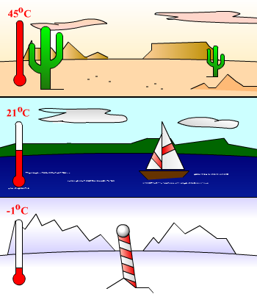
Skill Closure
Accidents in the Science Lab
Look at the table and answer the following questions on your whiteboard:
In which month did the most accidents happen?
How many accidents happened in April?
In which month did 6 accidents happen?
Month | Number of accidents
Jan | 0
Feb | 10
Mar | 6
Apr | 3
Skill Closure
A team of scientists measured the speed of sound at different air temperatures. They found that sound travels at 330 metres per second (m/s) at -1°C, 344 m/s at 21°C, and 358m/s at 45°C. Draw a table to display this information.
Reminders:
All tables need: A title Headings with units in the first row I.V. in the first column, D.V. in the second

Slide 12
Independent Practice
Answer the following questions, writing your answers in your book or device under the heading “Tables”.
A student was investigating how much energy his solar panels generated when he tilted them different amounts. He tested four different angles and wrote his results in the table below.
What has this student forgotten to add to his table? Why is this important?
At which angle did the solar panels generate the most energy?
At which angle did the solar panels generate the least energy?
Has this student put the correct variables in each column? Explain why or why not.
Another student conducts an experiment to see how much energy her solar panels generate each month. Create a table for her messy results.
“500 kWh in Feb, 620 kWh in Apr, 720 in Jun, 660 in Aug, 520 in Oct, 440 in Dec”
Angle (°) | Energy (kWh)
20 | 460
30 | 500
40 | 480
50 | 440
Reminders:
All tables need: A title Headings with units in the first row I.V. in the first column, D.V. in the second
Notes:
A title
30°
50°
Yes: the independent variable is in the first column and the dependent variable is in the second.

